Slide 1
Salesforce Basic Customization

Slide 2
Objective
At the end of the session, you will be able to:
Understand difference between standard and custom fields
Understand how to configure Custom fields
Understand how to configure Lookup fields, Auto Number, relationship using Schema Builder , Picklist, Formula fields
Understand what is field level security and how to configure it;
Understand what is page layout and how to configure page layout

Slide 3
Why use Force.com:
Proven — More than 100,000+ companies trust Force.com, including many industry leaders. They’ve built 220,000+ apps that run in accredited, world-class data centers with backup, failover, disaster-recovery, and an uptime record exceeding 99.9%. You can see real-time system performance data at trust.salesforce.com.
Agile — Force.com requires minimal coding. Assemble your apps in building-block fashion using our visual tools and library of components. Streamline development with sandbox environments, and integrate your apps using open APIs.
Social — Work more effectively with your colleagues using your own secure social network. Force.com includes pre-built components for feeds, profiles, conversations, updates, and file sharing. All components are available through REST APIs that can be easily integrated into any custom app. •
Mobile — Build native mobile apps powered by a secure cloud database, with rock-solid APIs. Or build mobile-optimized browser apps, using our UI framework and HTML5 to support any device with one code base. Or mix native and HTML in a hybrid cocktail that gives you the best of both worlds. Force.com has what you need to securely deliver apps on mobile devices.
Notes:
We will centered around building a very simple warehouse management system.

Slide 4
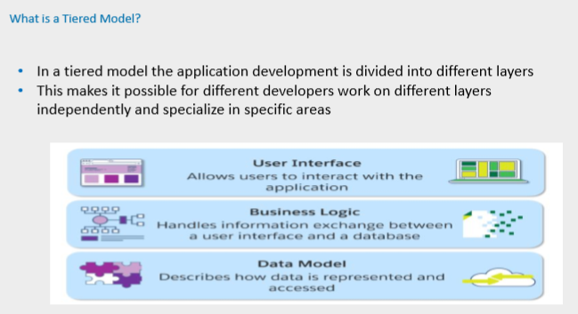
Notes:
You'll start developing the app from the bottom up; that is, you'll first build a database model for keeping track of merchandise. You'll continue by adding business logic: validation rules to ensure that there is enough stock, workflow to update inventory when something is sold, approvals to send email notifications for large invoice values, and trigger logic to update the prices in open invoices. Once the database and business logic are complete, you'll create a user interface to display a product inventory to staff, a public website to display a product catalog, and then the start of a simple store front.

Slide 5
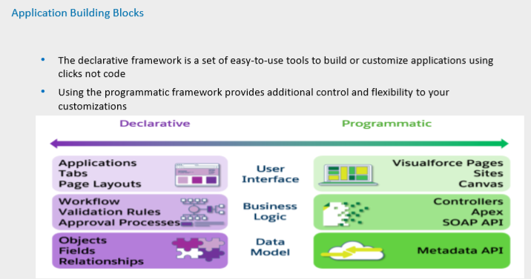

Slide 6
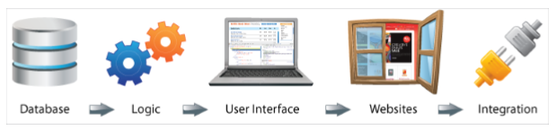
Warehouse Scenario

Slide 7
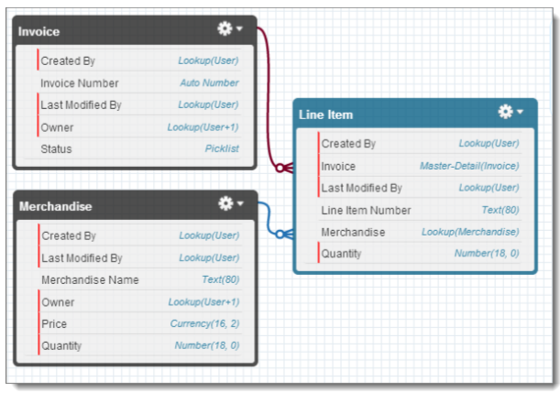
Warehouse Scenario

Slide 8
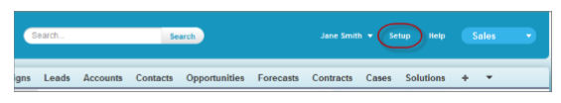
Create a Warehouse Custom App
Depending on your organization settings, you’ll access the Setup area in one of two ways. Look at the header at the top of the page.
If you see Setup in the header, click it.

Slide 9
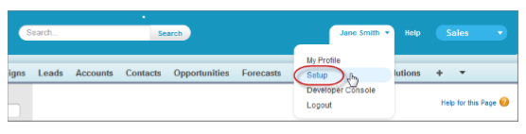
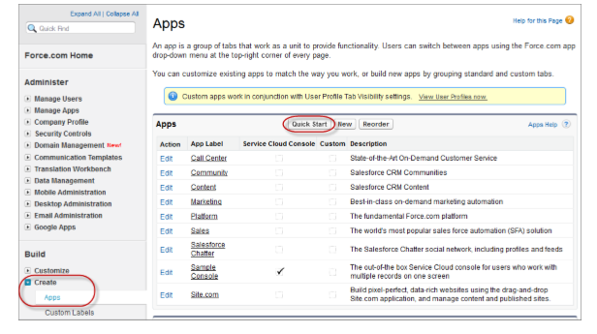
Create a Warehouse Custom App
If you don’t see Setup in the header, click your name, then select Setup.
Once you’re in the Setup area, you’ll see a menu on the left side of the page. Click Create > Apps.
5. Click Quick Start.

Slide 10
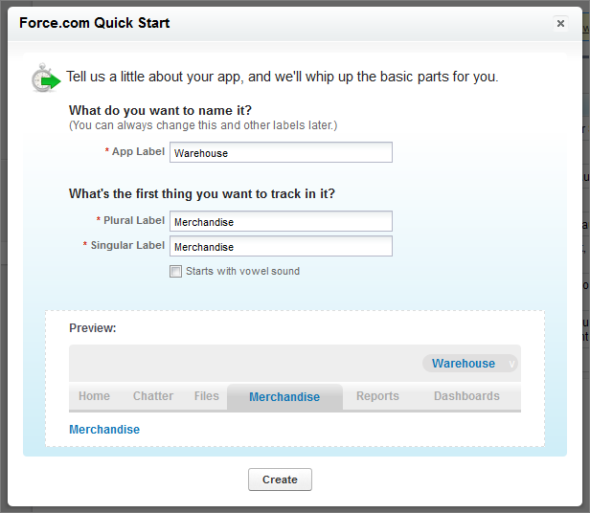
Create a Warehouse Custom App

Slide 11
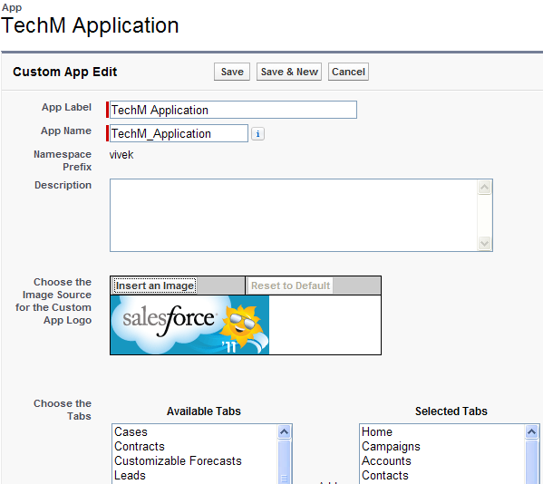
Create a Warehouse Custom App
To create a custom Application, Select
App Setup → Create → Apps and click on
‘New’ button
Give a Unique name and add brief description about this Application
Select a logo for this application (Size < 20 KB)

Slide 12
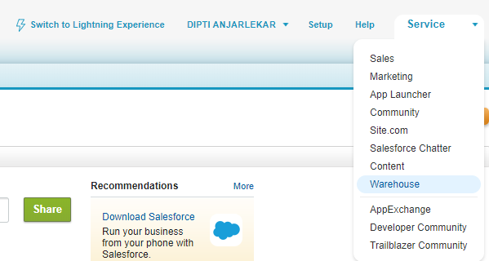
Custom Application
Choose the Tabs to be displayed in this application.
Assign application to Profiles.
User with this profile will be able to select new application.

Slide 13
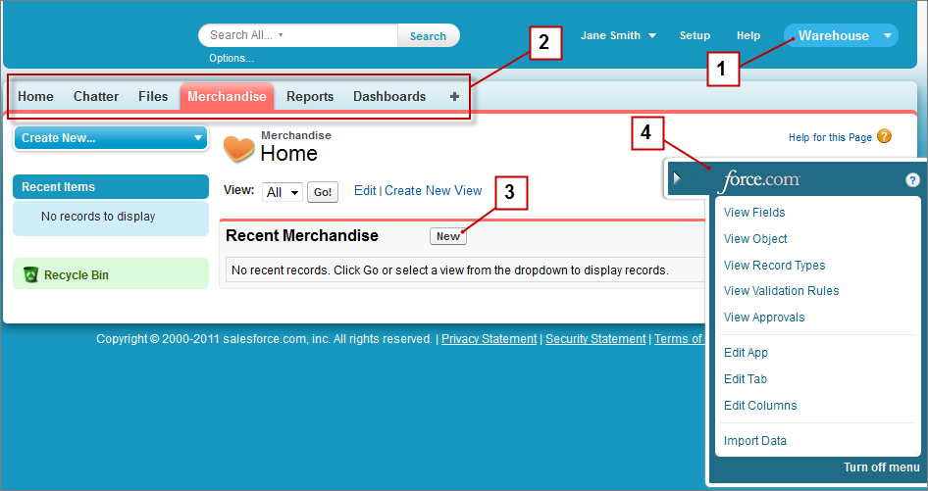
Scenario 1: Create a Warehouse Custom App
Requirement:create a Warehouse app, including Merchandise object and tab
Task:
1. setup – Build – Create- Apps
2. For the App Label, type Warehouse
3. For the Plural Label, type Merchandise.
4. For the Singular Label, type Merchandise

Slide 14
Salesforce Customization
Creating Custom Fields

Slide 15
Creating Custom Fields
Standard fields
Predefined,
Cannot be deleted
Can remove non required fields from user interface
Can use field level security to hide fields from UI
Custom Fields
New fields that one can create on any standard or custom object to capture additional information
Not built-in field
Can be customizable
Can be deleted if not require
Can be set default
Lookup Field
Dependent Field

Slide 16
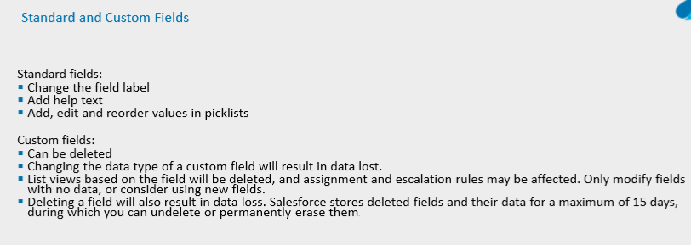

Slide 17
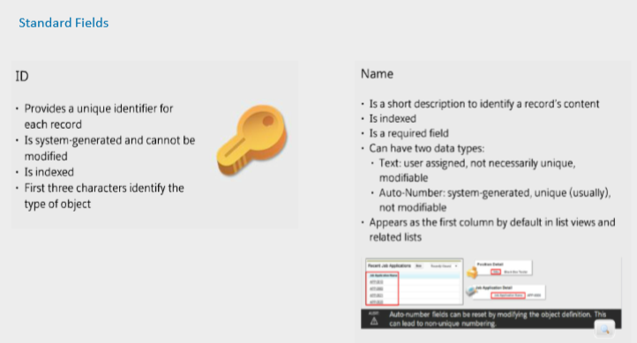
Notes:
alesforce platform is built on Oracle backend database, not just but a cluster of databases. They have built a layer of abstraction over that and you cannot access the database directly, but use their database queries (soql) f you go to the Quick find on the left (Setup mode) and type “Schema Builder”, you will find the Schema builder application that is out of the box now.

Slide 18
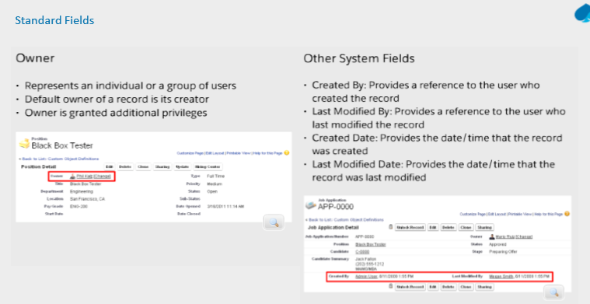

Slide 19
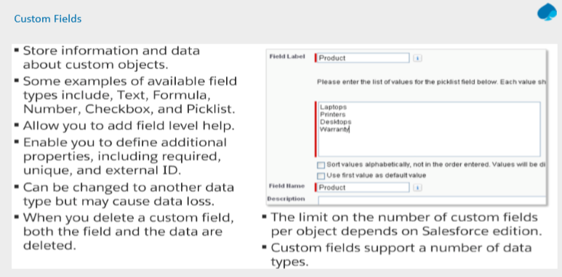

Slide 20
Warehouse Scenario

Slide 21
Scenario 2: Add Description, Price, and Total Inventory Fields
Requirement: A merchandise object should have fields that are used for tracking various information, such as a description, how much individual units cost, and how many units are in stock. You can add custom fields to list or track just about anything.

Slide 22
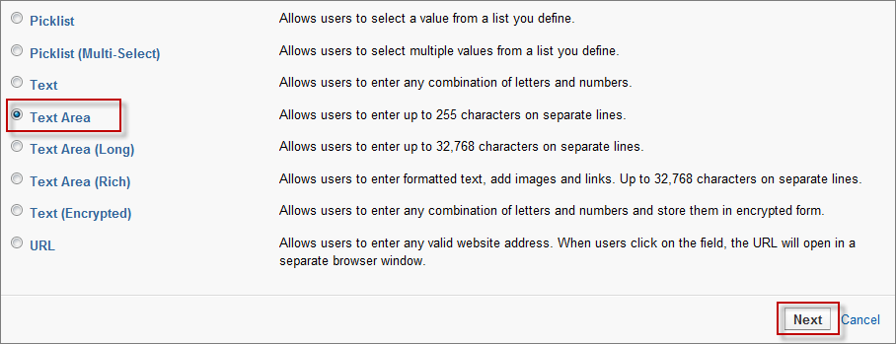
Create the field of type ‘Text Area’
1. From the Merchandise list view page, click to open the quick access menu (if it isn't already open).
2. Hover over View Fields and click New to launch the New Custom Field wizard.
3. For Data Type, select Text Area and click Next.
Notes:
For the Field Label, type Description and press the Tab key. • The Field Name field should already be populated with the field name: Description. • Select the Required checkbox. One of your business rules says that you can't create new merchandise without providing a description. Making Description a required field fulfills that business rule. • Optionally, fill in the Description and Help Text fields. It's a good idea to fill these in, but for the sake of brevity we leave these out in the remainder of the workbook. • Don't fill in the Default Value field.

Slide 23
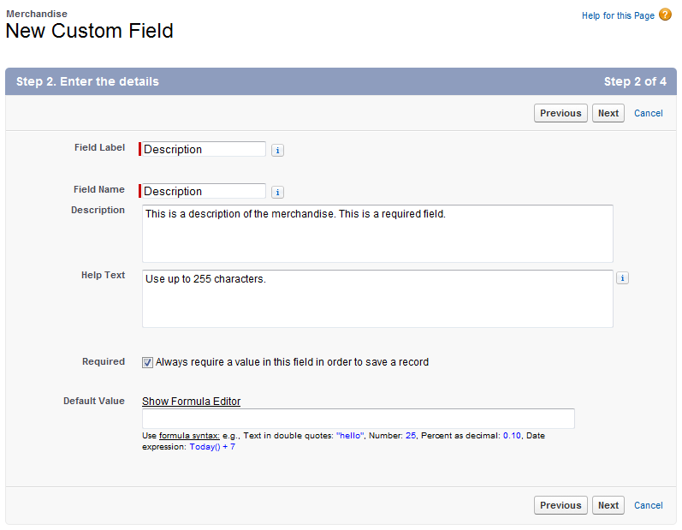
Create the field of type ‘Text Area’

Slide 24
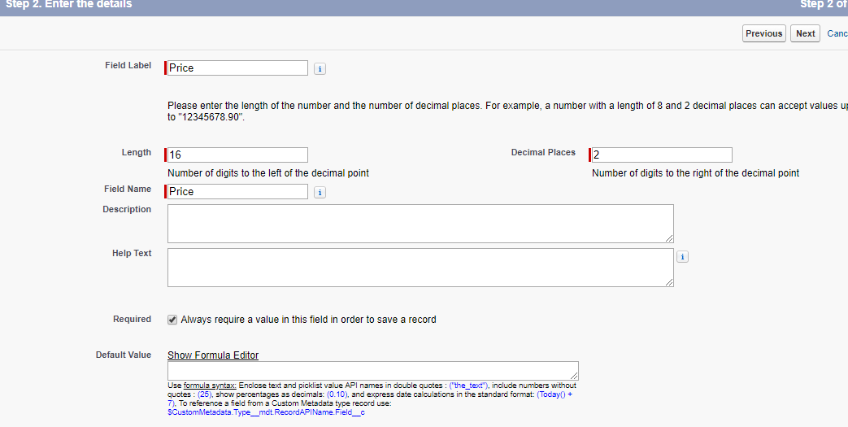
Create the field of type ‘Currency’

Slide 25
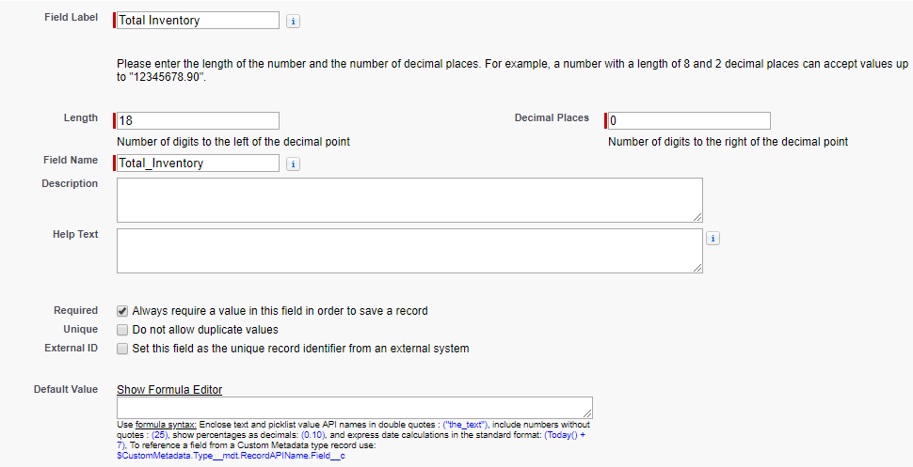
Create the field of type ‘Number’

Slide 26
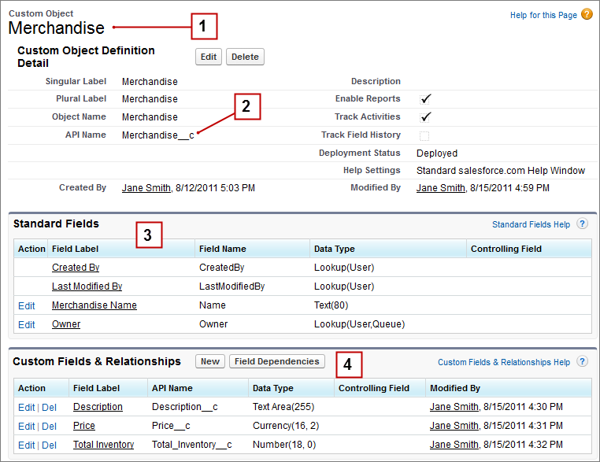
Scenario 2: Add Description, Price, and Total Inventory Fields
Notes:
Merchandise detail page—This page shows you everything you need to know about your Merchandise custom object. Soon you'll add relationships, validation rules, and other neat features to this object.
API name—When you created the Merchandise object, you didn't specify an API name, but one was generated for you. This name is how the object is referenced programmatically. All custom objects end in __c, which differentiates them from standard objects.
Standard fields—Some fields are generated automatically; these are standard fields. For example, the Merchandise object has a standard field for Owner, which means it automatically tracks who created each record.
Custom fields—Includes the fields you just created in this step. Like custom objects, custom fields have API names that end in __c.

Slide 27
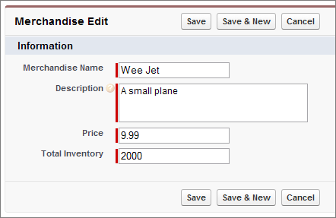
Scenario 2: Add Description, Price, and Total Inventory Fields

Slide 28
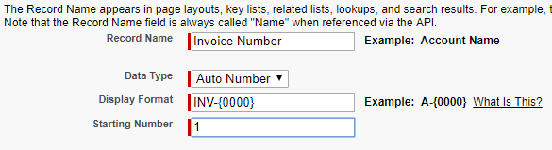
Create the field of type ‘Auto Number’
Specify Display Format for Auto Number field
A Display Format allows you to control the appearance of the Auto Number field.
A Display Format consists of the substitution variables, plus any other characters you wish to include as a prefix or suffix.

Slide 29
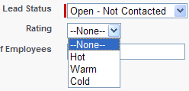
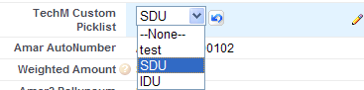
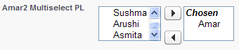
Create the field of type ‘PickList’
Picklist lets a users pick values from a predefined list instead of entering manually
Standard Picklist
Custom Picklist
Custom Multi-select picklist

Slide 30
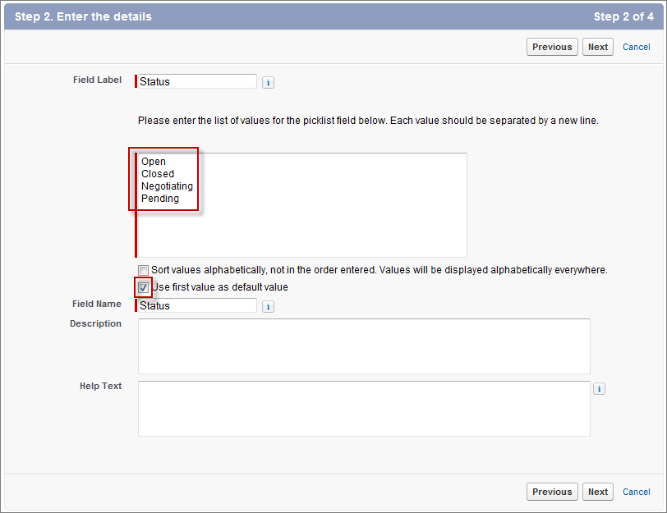
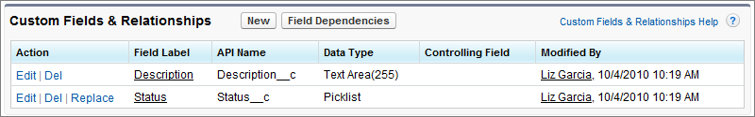
Create the ‘Status’ field of type ‘PickList’
Notes:
For field-level security, make sure Read Only is selected and then click Next.

Slide 31
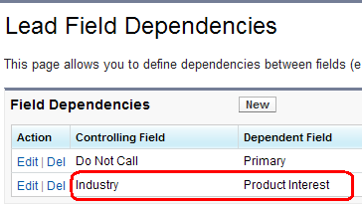
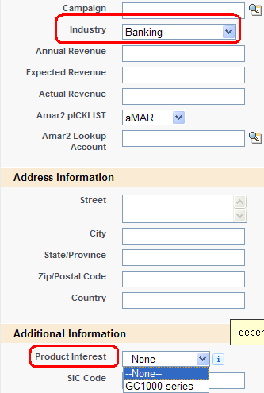
Create the field of type ‘Dependent PickList’
Values of a picklist are dependent on select of a value from another picklist
To define a dependent picklist
Select Setup →
App Setup → Lead (Object Name)
Fields → Field Dependencies

Slide 32
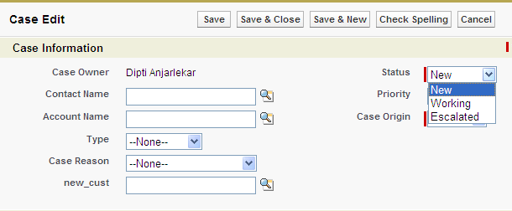
Dependent and controlling Picklists
Use dependent picklists to enter accurate and consistent data.
A dependent picklist is a custom or mutli-select picklist for which the valid values depend on the value of another field, called the controlling field.
Controlling fields can be any standard or custom picklist (with at least one and fewer than 300 values) or checkbox field on the same record.
The value chosen in controlling field affects the value available in dependent field

Slide 33
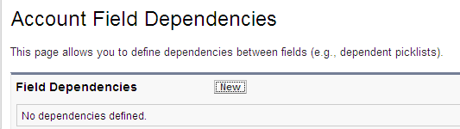
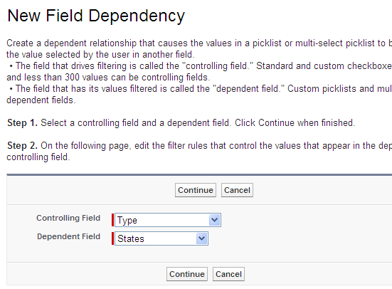
Create the field of type ‘Dependent PickList’
1) For standard objects, click Setup | Customize, select the appropriate object from the Customize menu, and click Fields
Eg: Setup | Customize | Account | field | Click Field Dependency button
2) Click New
3) Choose a controlling field and dependent field.

Slide 34
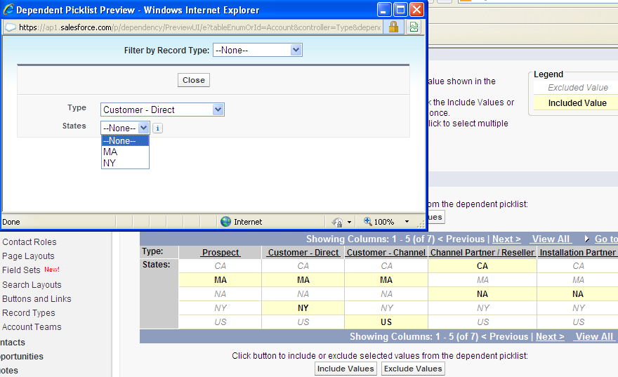
Create the field of type ‘Dependent PickList’
4) Use the field dependency matrix to specify the dependent picklist values that are available when a user selects each controlling field value.Click Preview to test your selections
5) Click Save.

Slide 35
Field Level Security (FLS)
Defines users’ access to view and edit specific fields in the application
User field level security rather than creating multiple page layout to enforce data security
Can not be used to make a field required. This is done from Page Layout
FLS can be defined using FLS and page layout. However the most restrictive field access setting of two will always apply

Slide 36
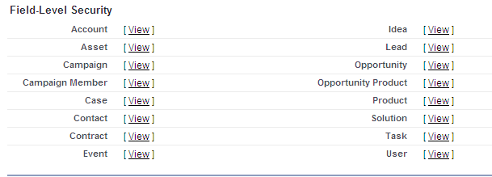
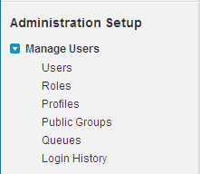
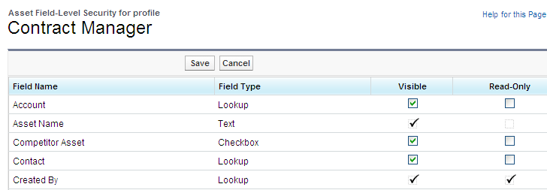
Field Level Security (FLS) Continue
Click Path to set FLS at profile Level:
Setup | Manage Users | Profiles | Filed Level Security | View
Step 2
Step 1
Step 3
Notes:
Check the visibility to make this field visible
Uncheck the field to hide this field
Check the read-only to make field visible but read-only

Slide 37
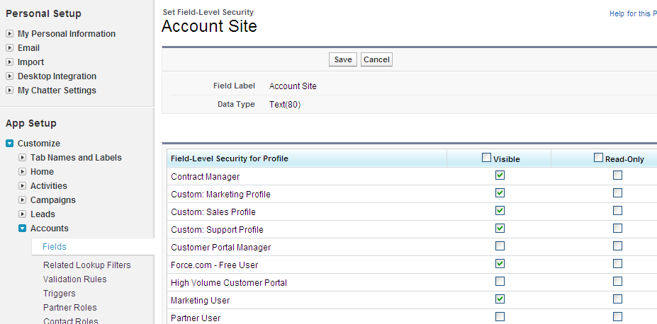
Field Level Security (FLS) Continue
Click path to set FLS at Field level on account object:
Setup | Customize | Account | Select field | Set FLS

Slide 38
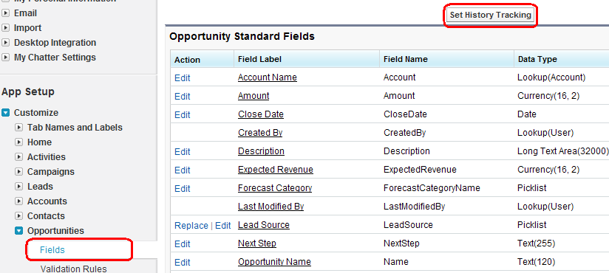
History Tracking
Salesforce tracks history of value change of the selected field.
Select the “Setup” option from the dropdown menu in the Home Screen to set History tracking of fields
App Setup | Customize | (Object Name) | Fields

Slide 39
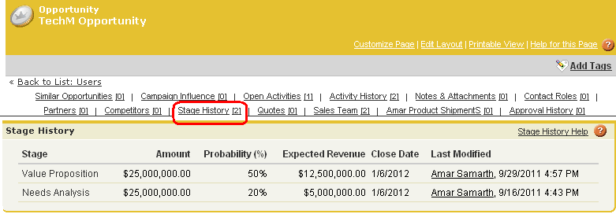
History Tracking
Field updates are tracked in the History related list.
History Tracking can be performed on fields of all Custom and Standard objects

Slide 40
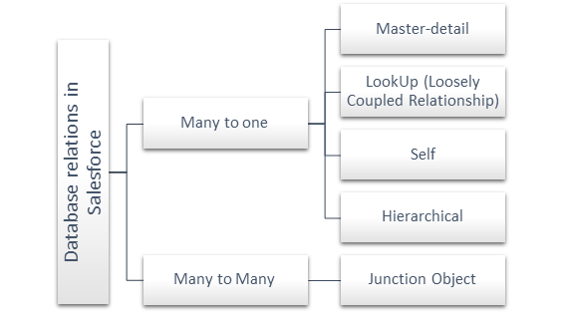
How are Database Relations defined in the Salesforce?
Notes:
They can be made one-to-one relationship by adding validation rules, or maybe triggers to enforce the one-to-one nature, i.e. only one child is allowed.

Slide 41
Master-Detail relationships
we have one parent object and multiple child objects. For this type of relationship, you need to keep the following facts in mind –
The child record will be deleted automatically, once the master record is deleted.
Every time you wanted to create a child object then the reference of the parent object is needed.
There are no separate permissions or security settings defined for the child object but they are automatically inherited by the parent object.
The owner settings are automatically assigned to associated master objects.
On the page layout, there is a master-detail relationship is defined for the object.
The administrator will decide either child objects should be represented within the parent object or not.
Notes:
master-detail relationships are not applicable to the object where User or Lead objects are defined as the master.

Slide 42
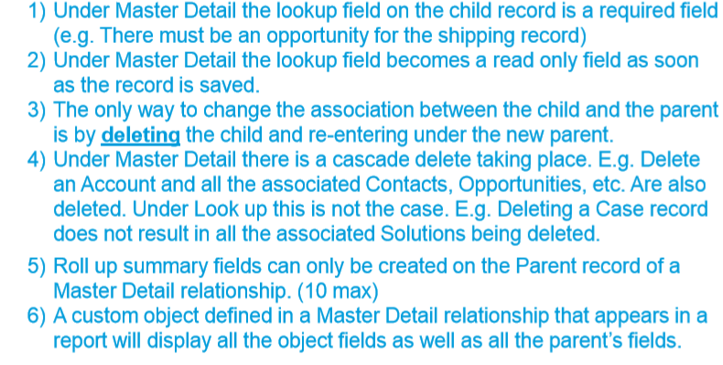
Master-Details relationship

Slide 43
Look up Relationship
Child objects are also independent. If we are deleting the parent object then child object will not get deleted.
The separate settings could be defined for the child object.
If we will delete the parent object then the child object would still remain into the system.
In this case, the child object may or may not have a parent.

Slide 44
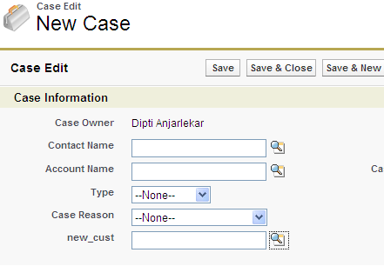
Lookup fields / Relationship
Links two objects together, but has no effect on deletion or ownership
The relationship field allows users to click on a lookup icon to select a value from a popup list. The other object is the source of the values in the list.
Link two different objects, custom and standard
Create lookup relationship between:
Standard object to
Users
Custom objects
Standard object
Lookup into contact Name

Slide 45
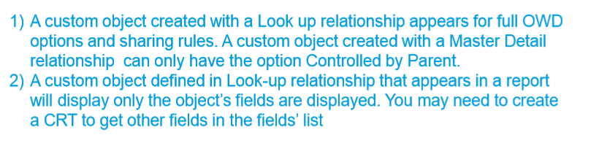
Look-up Relationship

Slide 46
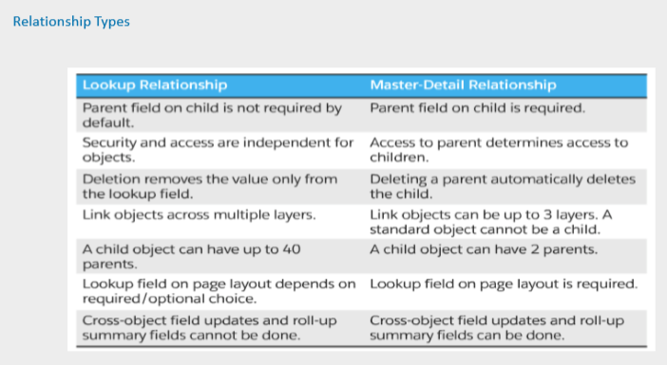

Slide 47
Self-Relationship
In this type of relationship, the object is self-referred.
For example, add-on card onto your credit card

Slide 48
Many to Many Relationship: Junction Object
This object is needed to create many-to-many relationships that support two type of relationships master-detail and the lookup relationships.
They both are one-to-many relationships and to define many-to-many relationships in that case, we need a Junction Object.
Notes:
In case of Many to many relationship, Child will inherit look and feel, owner property as that of primary master object (PMO field is the one which will get added into child object 1st). However security get inherited from both masters
total 40 relationship we can create it might be... 1) 38 lookups and 2 masterdetail or 2) 39 lookups and 1 master detail or 3) 40 lookups or 0 masterdetail relationships

Slide 49
Hierarchical Relationship:
It is very much similar to the lookup relationship but it can be defined for user objects only.
Further, you can use lookup fields to connect multiple users together.
User objects may refer to themselves either directly or indirectly.

Slide 50
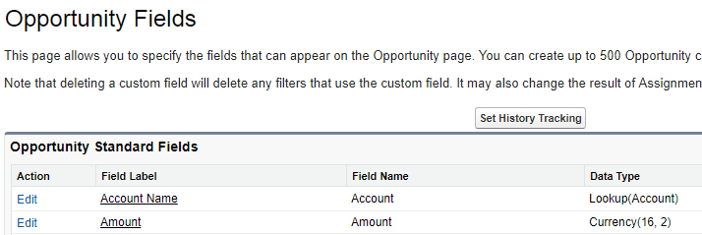
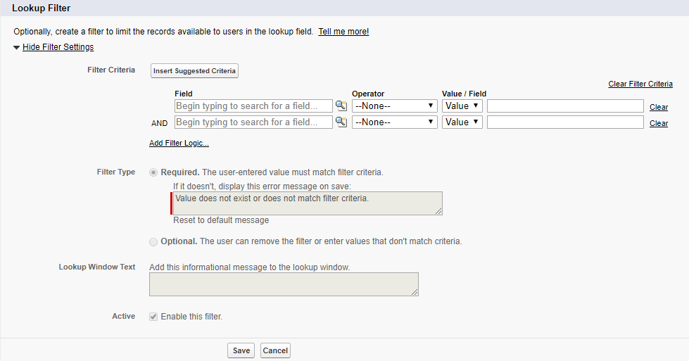
Lookup Filter
Lookup Filter is a filter to limit the records available to users in the lookup field

Slide 51
Scenario 3: Relate the Objects
Requirement: The Line Item is related to both an Invoice Statement (a statement is composed of a number of line items) and Merchandise (a line item takes its price from the merchandise).
Notes:
On the detail page of the Line Item object, scroll down to the Custom Fields & Relationships related list and click New.
In the Data Type field, select Master-Detail Relationship and click Next.
In the Related To field, select your Merchandise custom object and click Next.
Accept the defaults on the next three screens by clicking Next.
Deselect the checkbox next to Merchandise Layout so that Line Items don't appear on the Merchandise related list.
Click Save & New.
In the Data Type field, select Master-Detail Relationship and click Next.
In the Related To field, select your Invoice Statement custom object and click Next.
Accept the defaults on the following screens by clicking Next, and then click Save to return to the Inventory Item detail screen.

Slide 52
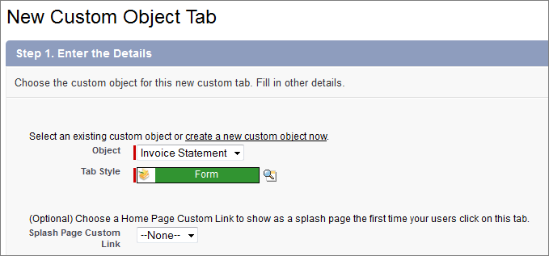
Scenario 4: Add Invoice Statements to the App
Requirement: Tabs provide an easy way to find and organize objects and records. In this step you'll create a tab for the Invoice Statement object and add it to your Warehouse app. This will expose the user interface that Force.com automatically generates for this object.

Slide 53
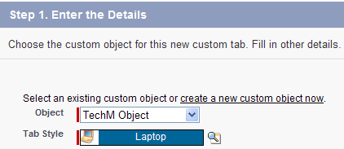
Custom Tabs
Refer an existing object or create a new custom object for the new custom Tab
To create custom object, Select
App Setup → Create → Objects and click on ‘New’ button.
To create custom Tab, Select
App Setup → Create → Tabs and click on ‘New’ button.

Slide 54
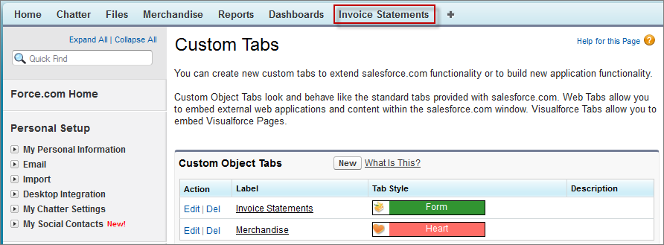
Add Invoice Statements to the App

Slide 55
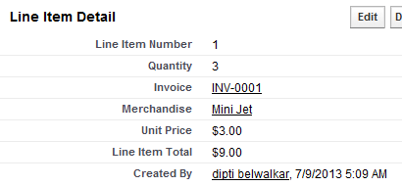
Formula Fields
It is a read-only field that derives its value from a formula expression you define.
The formula field is updated when any of the source fields changes
Eg: Line Item Total is Unit Price * Quantity

Slide 56

Creating Formula Fields
Select Setup | App setup | Customize | <Object> | Fields
Click on New
Select type of Data want as Formula, & click on Next

Slide 57

Calculate a Value for Each Line Item
Requirement: add a new calculated field called Value to the line item. This field will multiply the number of items with the price and act as a total for each line item
Using Simple Formula tab, In the Insert Merge Field drop-down list, select appropriate field.
Click the Insert Operator and choose Appropriate Operator.
Eg. You want to have Unit_Price__c * Units_Sold__

Slide 58

Creating Formula Fields – Advanced Formula
One can even improve validation rule or improve formula by adding Advanced Formulas
In Advanced Formula tab, select appropriate function as per business requirement

Slide 59
Creating Formula Fields – Advanced Formula
Function | Description | Function with example
IF(logical_test, value_if_true, value_if_false) | replace logical_test with the expression you want evaluated; replace value_if_true with the value you want returned if the expression is true; replace value_if_false with the value you want returned if the expression is false. | IF(AND(Payment_Due_Date__c < TODAY(),​​Payment_Status__c ="UNPAID") , "PAYMENT OVERDUE", ​null)
ISBLANK(expression). | Determines if an expression has a value and returns TRUE if it does not. If it contains a value, this function returns FALSE. | IF(ISBLANK(Amount), 0, 1)
LN(number) | Returns the natural logarithm of a specified number. Natural logarithms are based on the constant e value of 2.71828182845904 | LN(10) returns the natural logarithm of 10, which is 2.30

Slide 60
Creating Formula Fields – Advanced Formula
Function | Description | Function with example
ISNEW() | Checks if the formula is running during the creation of a new record and returns TRUE if it is. If an existing record is being updated, this function returns FALSE | NOT(OR(ISNEW(),HasOpportunityLineItem))
LEFT(text, num_chars) | Returns the specified number of characters from the beginning of a text string | TRIM(LEFT(LastName, 5)) & "-" & TRIM(RIGHT(SSN__c, 4))
VALUE(text) | Converts a text string to a number | VALUE(Lead_Number__c) returns a number for the text value in the auto-number field Lead Number.
REGEX(text, regex_text) | Compares a text field to a regular expression and returns TRUE if there is a match. Otherwise, it returns FALSE. A regular expression is a string used to describe a format of a string according to certain syntax rules | NOT( OR( LEN (SSN__c) = 0, REGEX(SSN__c, "[0-9]{3}-[0-9]{2}-[0-9]{4}") ) )

Slide 61
Roll-Up Summary Field
We have the total for each line item, it makes sense to add them all to get the invoice total. Because the line items have a master-detail relationship with the invoice statement,
we can use a roll-up summary field to calculate this value. Roll-up summary is a special type of field that lets you aggregate information about related detail (child) objects.
In this case, you want to sum the value of each line item.

Slide 62

Roll-Up Summary Field

Slide 63
Schema Builder
Schema Builder provides a dynamic environment to add new custom objects, custom fields, and relationships to your schema.
This eliminates the need to click from page to page to find the details of a master-detail relationship or to add a new custom field to an object in your schema.
For example, if you’re using Schema Builder to view the details of your schema, you can add a new custom object without leaving Schema Builder. The drag-and-drop interface lets you easily add a custom object or new field, and saves the layout of your schema any time you move an object.
Schema Builder provides details such as the field values, required fields, and how objects are related by displaying lookup and master-detail relationships.
You can view the details for both standard and custom objects in Schema Builder.

Slide 64

Working with Schema Builder
You can access Schema Builder in three ways:
From Setup, click Schema Builder.
From Setup, click Create | Objects. Then in the custom objects page, click Schema Builder.
In the Quick Links box on the Force.com home page, click Schema Builder.

Slide 65

Working with Schema Builder
The Objects tab lets you select objects to display on the canvas.
Click the drop-down list in the sidebar to filter your list of objects:
All Objects
Selected Objects
Standard Objects
Custom Objects
System Objects
The Elements tab lets you drag and drop new
custom objects and fields onto the canvas.
To create a new custom object,
To create a new custom field,

Slide 66
Working with Schema Builder
Hover over relationship lines to show relationship details such as lookup and master-detail relationships.
Click the name of the object to find it on the canvas.
You may want to hide relationships if your schema is taking too long to load.
Click to:
Hide Object on Canvas
View Object detail in a new window
View Page Layouts detail in a new window
Click Show More Fields to display all the fields of an object
To zoom in, click . , To zoom out, click .
The map in the lower right corner shows the overall layout of your objects on the canvas. Click on the map to navigate the layout of your objects. To pan across the schema layout while zoomed in, click and hold the canvas while moving the mouse.

Slide 67
Salesforce Customization
Page Layouts

Slide 68


Page Layouts
Page layouts control the layout and organization of detail and edit pages
Control which fields, related lists, and custom links users see, on detail and edit pages only
Determine whether fields are visible, read only, or required, on detail and edit pages only
To customize page Layouts for Opportunity
Select Setup | App Setup | Customize | Opportunities | Page Layouts

Slide 69
Page Layouts
Control the layout and organization of fields,Visualforce related lists, and custom links on detail and edit pages
Show or hide standard and custom buttons on detail pages.
Set which fields are visible, read only, or required on detail and edit pages.
In Personal,Contact Manager,Group, and Professional Editions, control which fields users can access in list views, reports,Force.com Connect Offline, and when synchronizing data.
Control the fields displayed on portal objects in the Customer Portal.

Slide 70

Understand a Page Layout
The editor has upper and lower sections. The upper section is a retractable toolbox called the palette. The lower section is the preview pane.
Notes:
When you scroll down the page, the palette moves with you, which makes it easy to edit longer pages.
In the page layout, several sections organize related information. • The Highlights Panel is useful for displaying key information at the top of the page. • The Quick Actions in the Salesforce Classic Publisher section is useful for customizing the actions that appear in the publisher in the full Salesforce site. • The Salesforce1 and Lightning Experience Actions section enables you to customize the actions that appear in Salesforce1. • At the top of the Invoice Detail is the area for standard buttons (Edit, Delete, and so on) and custom buttons. • Next comes the Invoice Detail, which has three default sections. – Information typically contains fields that users can manipulate at some point during the lifecycle of a record (creation and updates). By default, this section has two columns for fields. – System Information typically contains fields that the platform automatically maintains—fields that users cannot edit. This section is also a two-column layout. – Custom Links typically contains custom navigation links. • Below Invoice Detail is a section for Mobile Cards. By default, this section is empty. Mobile cards only appear in Salesforce1. • Last on the page is a related list for related Line Items

Slide 71


Page Layouts
User can Query and Add / Remove an identified item in page layout
User can drag and drop a selected item in page layout

Slide 72



Page Layouts - Steps
1. Click on Edit or Create new Page Layout
2. Provide require details 3. Drag and drop fields in section

Slide 73

Page Layouts - Steps
4. Preview your work done as a specific user
5. Save your work done

Slide 74


Page Layouts - Steps
6. Now assign this layout to user, by clicking on Page Layout Assignment button
7. Click on Edit Assignment
to assign profile to
appropriate pages

Slide 75

Page Layouts - Steps
8. Select 1st and last record by pressing shift key which selects all records
9. Select Page Layout To use and click on Save for assignment

Slide 76

Page Layouts - Steps
10. Verify your changes, by selecting account from All Accounts view
Note: If you need to modify a field that has data associated with it, in most situation changing the Data Type custom field will result in data lost

Slide 77

Scenario 5: CUSTOMIZE A USER INTERFACE
Requirement : Create a custom view that only shows invoices with a status of Closed.

Slide 78


Scenario 6: Modify a Page Layout
Requirement : Rearrange Fields on a Invoice Page Layout & Add ‘Merchandise’ and ‘Quantity’ Fields to the Related List (Line Item)

Slide 79


Scenario 7: Edit a Mini Page Layout
When you are in the Warehouse app, notice the Recent Items sidebar. Specifically, move over a recent invoice and notice that you get a mini page popup that previews the invoice information

Slide 80


Slide 81
Customize a Layout for Mobile Access
An object with a hundred fields might be difficult to use on a phone. We need to create a mobile-specific page layout. A mobile-optimized layout can be assigned to different roles, so that people who primarily use a phone get the mobile version, while desktop-only users get the standard version.

Slide 82



Create a compact layout
Salesforce1 uses compact layouts to display a record's key fields at a glance.
Step 1
Final Output
Step 2

Slide 83


Add Mobile Cards to the Related Information Page
Add related lookup card to the Merchandise object. Merchandise already has a lookup field that’s automatically generated, ‘Created by’, ‘Last Modified By’ so you can use that.

Slide 85



Enable Social Collaboration

Slide 86
Summary
This module showed you
Understand difference between standard and custom fields
Understand how to configure Custom fields
Understand how to configure Lookup fields, Auto Number, relationship using schema Builder, Picklist, Formula fields
Understand what is field level security and how to configure it;

Slide 87
Check Your Knowledge
1. A company needs to track the manufacturer and model for specific car companies. How can the system administrator ensure that the manufacturer selected influences the values available for the model? A. Create the manufacturer field as a dependent picklist and the model as a controlling picklist. B. Create a lookup field from the manufacturer object to the model object. C. Create the manufacturer field as a controlling picklist and the model as a dependent picklist. D. Create a multi-select picklist field that includes both manufacturers and models.
2. A manager wants to calculate the number of days since an account was last contacted through email. Which field type should be used to accomplish this? A. Formula B. Number C. Roll-up Summary D. Date
3. An app builder would like to streamline the user experience by reflecting summarized calculations of specific fields on various objects. Which field types could be used in roll-up summary fields to accomplish this? Choose 3 answers A. Currency B. Percent C. Date D. Checkbox E. Time
Notes:
C
A
A,B,C

Slide 88
Check Your Knowledge
4. What is a true statement regarding roll-up summary fields? Choose 2 answers A. Roll-up summary fields can only be created on the master of a master-detail relationship. B. The roll-up summary field inherits the field – level security of the child object. C. Changes to the value of a roll-up summary field column of roll-up summary filters. D. Multi-select picklist fields can be used in the field column of roll-up summary filters
5. Universal Containers uses a custom object to track open job positions. They would like to automatically post updates on a record’s feed whenever a position stage is changed. Which social feature can be used to accomplish this? A. Workflow rule B. Feed Quick Action C. Auto-response rule D. Feed tracking
6. An app builder has been asked to provide users a way to identify a contact’s “preferred contact method” directly on the contact record. users need to be able to identify whether a phone number or an email, is the contact’s preferred communication method. which field type will allow the app builder to accomplish this with the fewest fields possible? A. formula B. checkboxes C. picklist D. email
Notes:
C
A
A,B,C
A,C
D
C

Slide 89
Thank you

